Slide 1
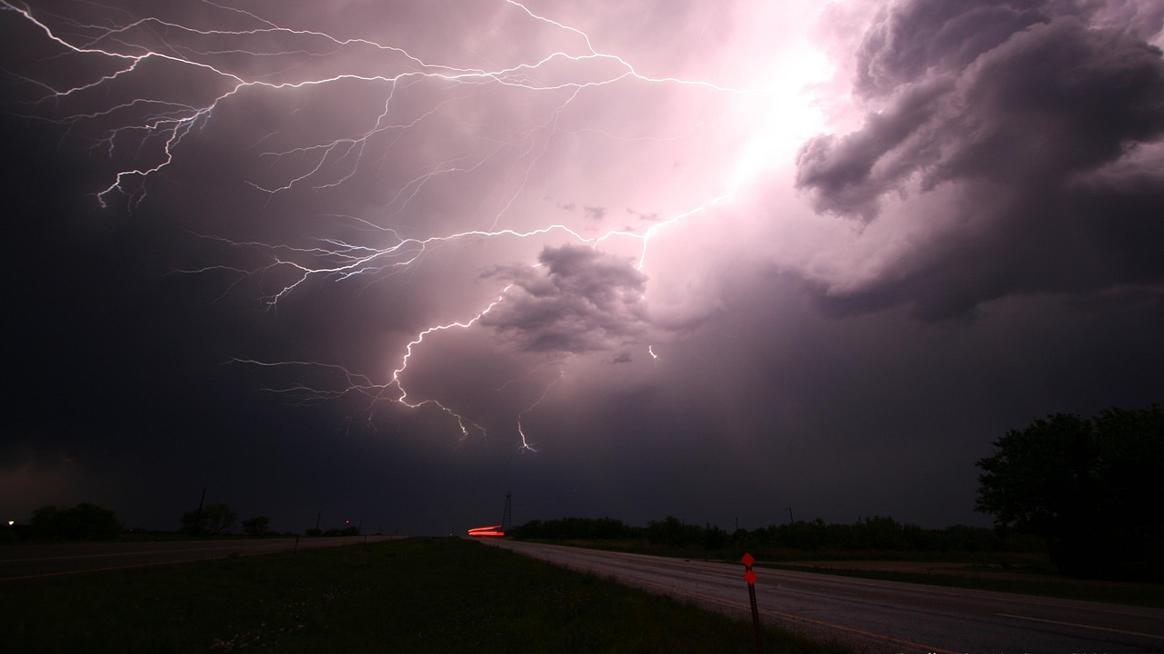
&
LIGHTNING
THUNDERING

Slide 2
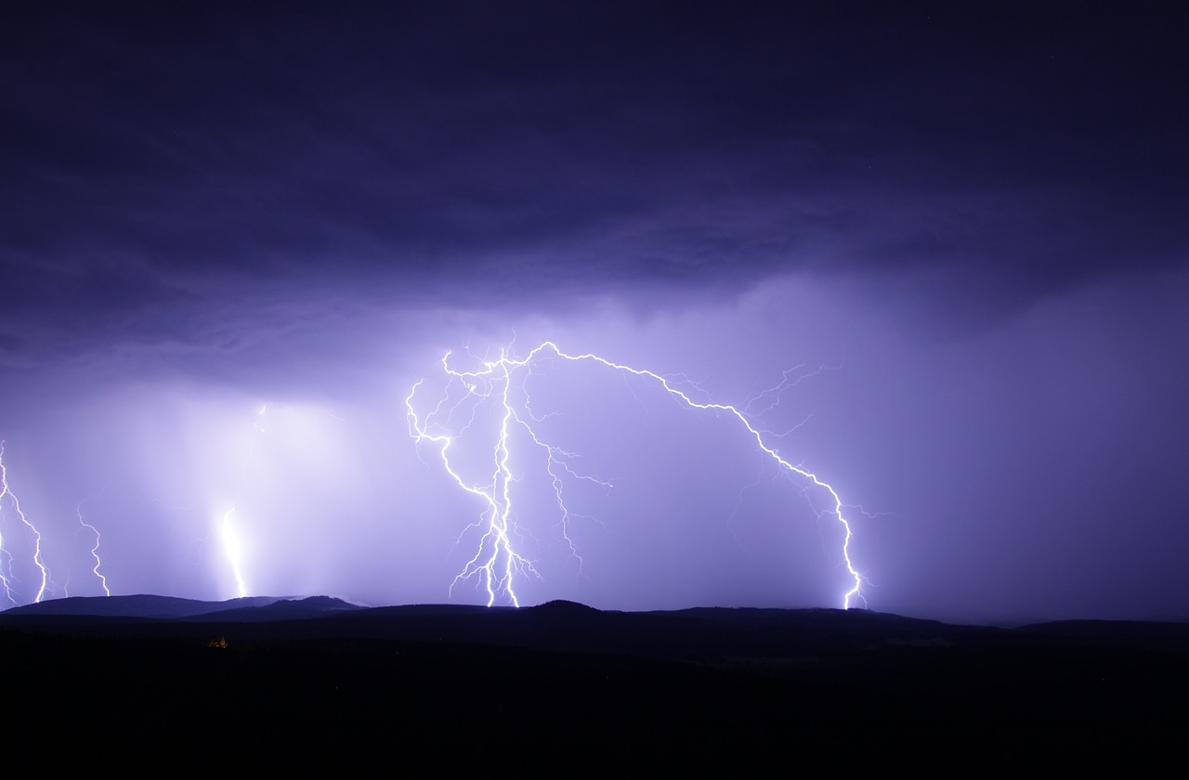
The Science of Lightning Lightning is a powerful electrical discharge produced by the atmosphere. It occurs during thunderstorms and is accompanied by the sound of thunder. The process involves the build-up and release of electrical energy, creating awesome inspiring displays in the sky.

Slide 3
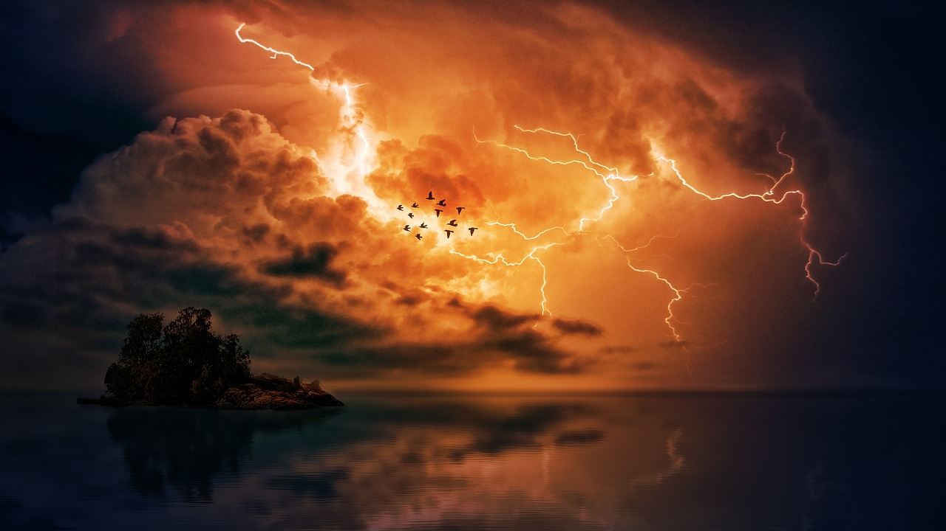
Thunder : natures roar When lightning strikes, it superheats the surrounding air, causing it to rapidly expand and create a shockwave. This shockwave is what we hear as thunder. The intensity and duration of the sound depend on the distance and strength of the lightning strike.

Slide 4
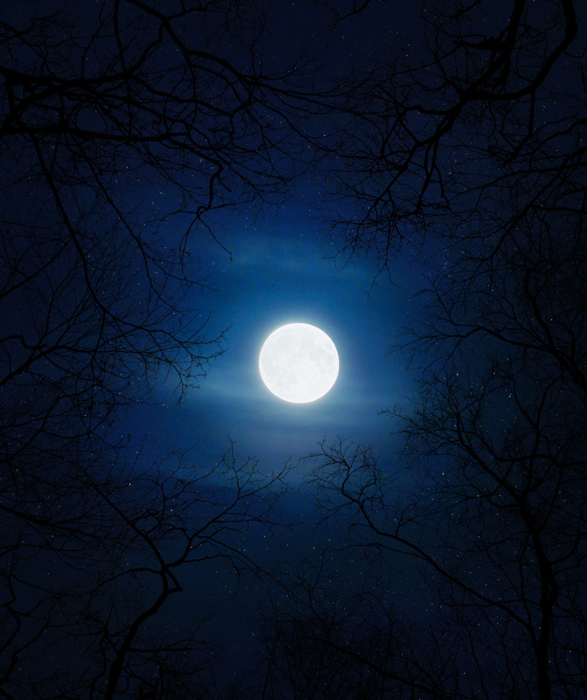
Main types of lightning
EARTH LIGHTNING
CLOUD LIGHTNING
AIR LIGHTNING
Earth lightning is an electrical discharge that transfer from a cloud to the earth
Cloud lightning is an electrical discharge that transfer through the cloud or between two clouds
Air lightning is an electrical discharge that transfer from a cloud into the air

Slide 5
Main types of lightning
EARTH LIGHTNING
CLOUD LIGHTNING
AIR LIGHTNING
Earth lightning is an electrical discharge that transfer from a cloud to the earth
Cloud lightning is an electrical discharge that transfer through the cloud or between two clouds
Air lightning is an electrical discharge that transfer from a cloud into the air

Slide 6
Main types of lightning
EARTH LIGHTNING
CLOUD LIGHTNING
AIR LIGHTNING
Cloud lightning is an electrical discharge that transfer through the cloud or between two clouds
Earth lightning is an electrical discharge that transfer from a cloud to the earth
Air lightning is an electrical discharge that transfer from a cloud into the air

Slide 7
Main types of lightning
EARTH LIGHTNING
CLOUD LIGHTNING
AIR LIGHTNING
Air lightning is an electrical discharge that transfer from a cloud into the air
Earth lightning is an electrical discharge that transfer from a cloud to the earth
Cloud lightning is an electrical discharge that transfer through the cloud or between two clouds

Slide 8
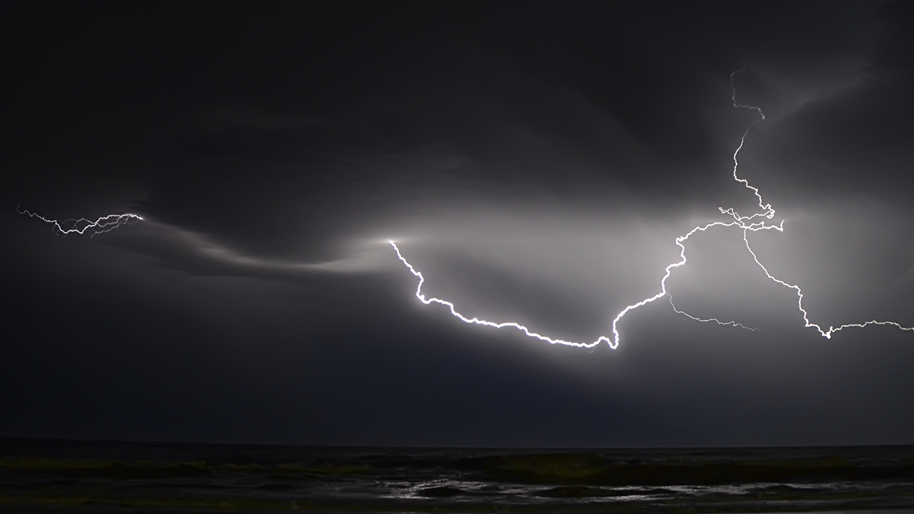
While the beauty of lightning and thunder is mesmerizing, it's important to remember the associated risks. When outdoors, seek shelter in a sturdy building or vehicle during thunderstorms. Avoid open fields, tall trees, and bodies of water to minimize the danger of lightning strikes.
!
Safety Precautions

Slide 9

1. keeping the electrical appliances disconnected from the circuits 2. keeping the disconnected plug of television antenna 3. Refraining from using and touching metal equipment 4. Refraining from using telephones
!
Some protective measures to follow on a lightning condition

Slide 10
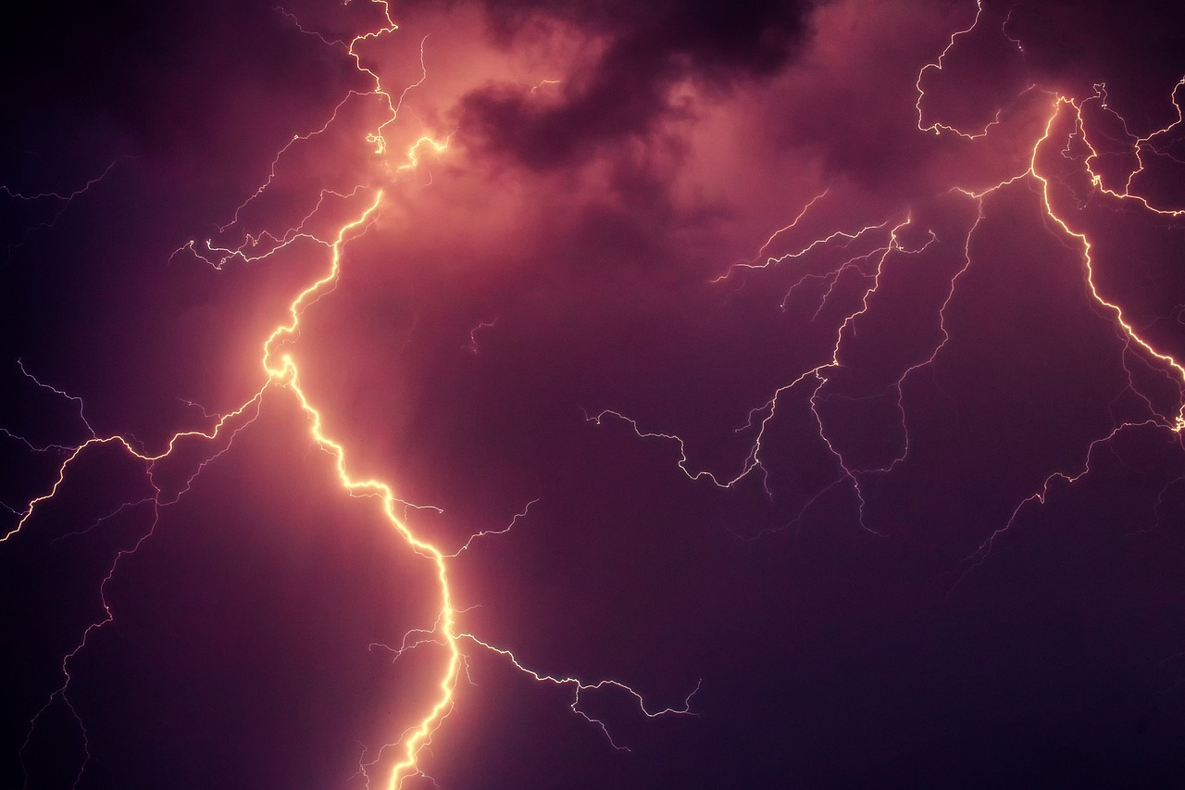
Impact on nature The occurrence of lightning plays a significant role in the natural environment. It can cause wildfires, trigger chemical reactions in the atmosphere, and contribute to the nitrogen cycle. Thunder also has cultural significance, often symbolizing power and divine forces in various mythologies.

Slide 11
Exploring the phenomena of lightning and thunder has provided us with a deeper understanding of the forces of nature. From the scientific mechanisms to the cultural impact, these natural wonders continue to captivate and inspire awe. Let's continue to marvel at the power and beauty of these electrifying phenomena
Conclusion

Slide 12


Credits :

Slide 13
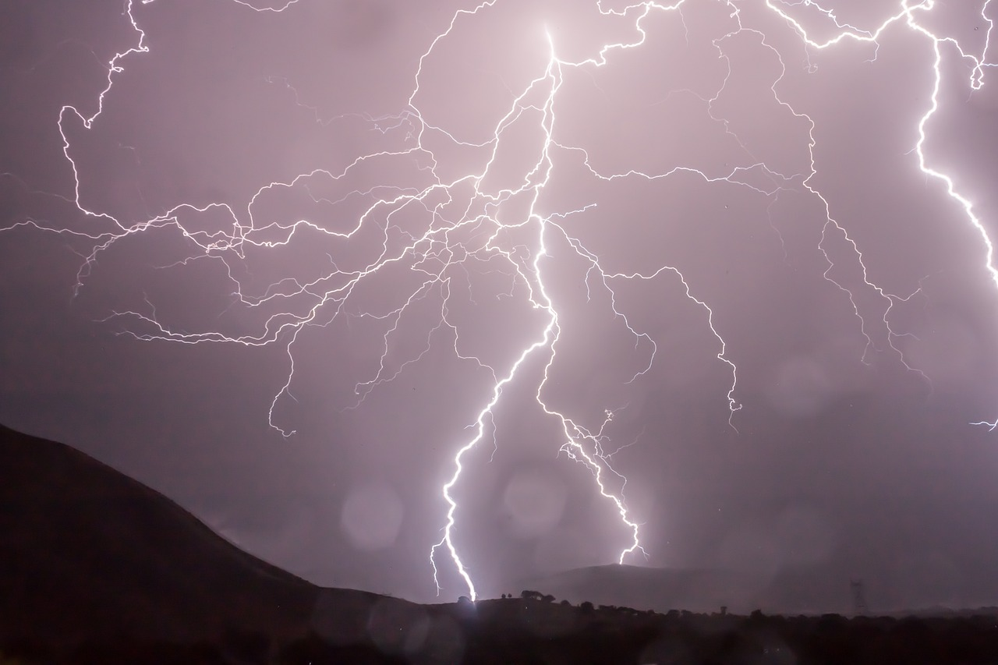


thank you
Created by:
Diniru Gajanayake
Presented by:
Diniru Gajanayake
Dinura Dinudika

